Slide 1
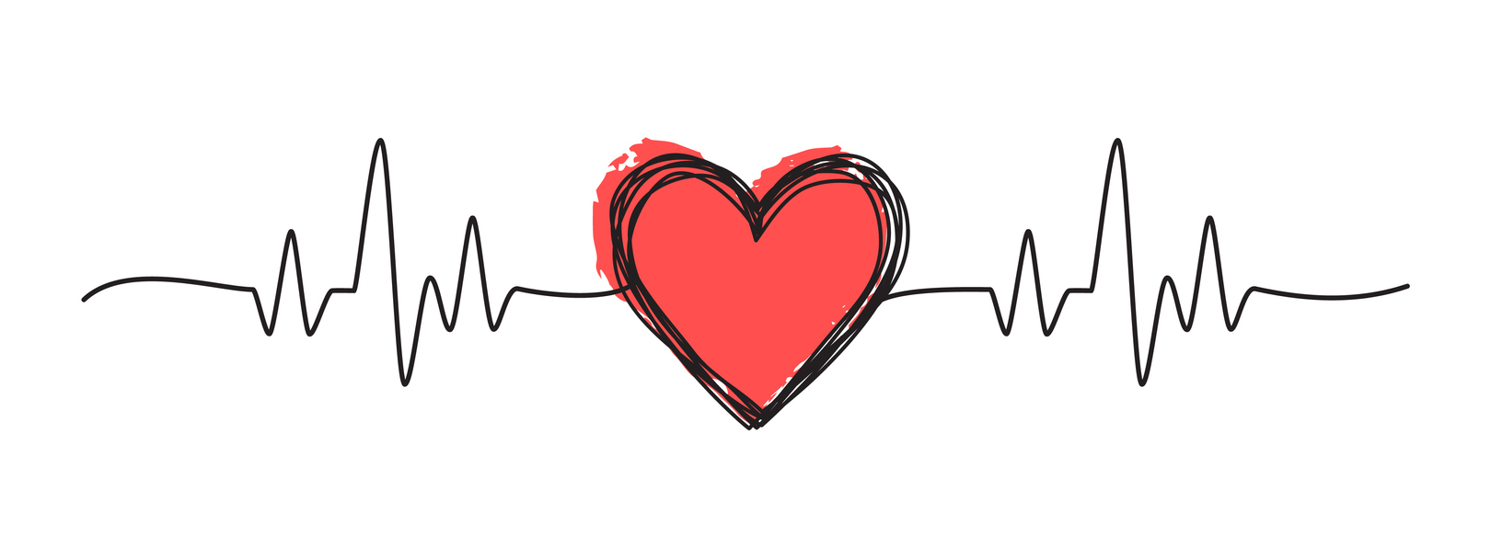
Heart disease prediction using machine learning
Final Year Project CSE (2019-2023)
By: Mentor:
Amit Kumar Tripathi Ms. Shikha Jain
Abhishek Namdeo
Divyansh

Slide 2
Introduction
Heart diseases is a term covering any disorder of the heart. Heart diseases have become a major concern to deal with as studies show that the number of deaths due to heart diseases have increased significantly over the past few decades in India, in fact it has become the leading cause of death in India.
A study shows that from 1990 to 2016 the death rate due to heart diseases have increased around 34 per cent from 155.7 to 209.1 deaths per one lakh population in India.
Thus preventing heart diseases has become more than necessary. Good data-driven systems for predicting heart diseases can improve the entire research and prevention process, making sure that more people can live healthy lives. This is where machine learning comes into play. Machine learning helps in predicting the heart diseases, and the predictions made are quite accurate.

Slide 3
Problem Description
A dataset is formed by taking into consideration some of the information of 920 individuals. The problem is : based on the given information about each individual we have to calculate that whether that individual will suffer from heart disease.

Slide 4
Technologies Used
Python
Sklearn
Numpy
Pandas
Matplotlib
VS code & Jupyter Notebook

Slide 5
Dataset
The Dataset is taken from UC Irvine Machine Learning Repository popularly known as UCI
The Heart disease data set consists of patient data from Cleveland, Hungary, Long Beach and Switzerland. The combined dataset consists of 14 features and 916 samples with many missing values.
Our data has 3 types of data:
Continuous (#): which is quantitative data that can be measured
Ordinal Data: Categorical data that has a order to it (0,1,2,3, etc.)
Binary Data: data whose unit can take on only two possible states ( 0 &1 )

Slide 6
Age : displays the age of the individual.
Sex : displays the gender of the individual using the following format : 1 = male 0 = female.
Chest-pain type : displays the type of chest-pain experienced by the individual using the following format : 1 = typical angina 2 = atypical angina 3 = non - anginal pain 4 = asymptotic
Resting Blood Pressure : displays the resting blood pressure value of an individual in mmHg (unit)
Serum Cholesterol : displays the serum cholesterol in mg/dl (unit)
Fasting Blood Sugar : compares the fasting blood sugar value of an individual with 120mg/dl. If fasting blood sugar > 120mg/dl then : 1 (true) else : 0 (false)
Resting ECG : 0 = normal 1 = having ST-T wave abnormality 2 = left ventricular hypertrophy
Max heart rate achieved : displays the max heart rate achieved by an individual.
Exercise induced angina : 1 = yes 0 = no
ST depression induced by exercise relative to rest : displays the value which is integer or float.
Peak exercise ST segment : 1 = upsloping 2 = flat 3 = down sloping
Number of major vessels (0-3) colored by fluoroscopy : displays the value as integer or float.
Thala : displays the thalassemia : 3 = normal 6 = fixed defect 7 = reversable defect
Diagnosis of heart disease : Displays whether the individual is suffering from heart disease or not : 0 = absence 1 = present.
Dataset Description of Attributes

Slide 7
Algorithms to be used
Support Vector Machines
Decision Tree Classification
Random Forest Classification
K-Nearest Neighbour (KNN)

Slide 8
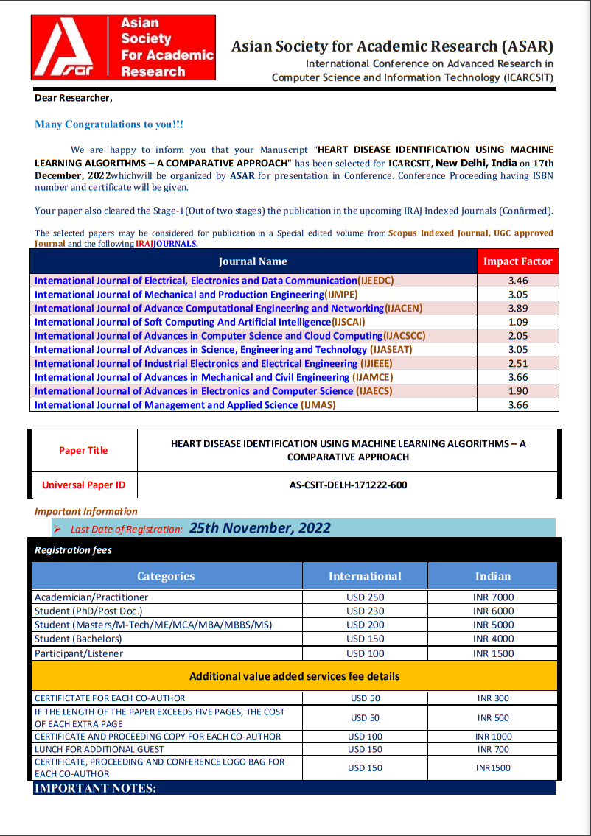
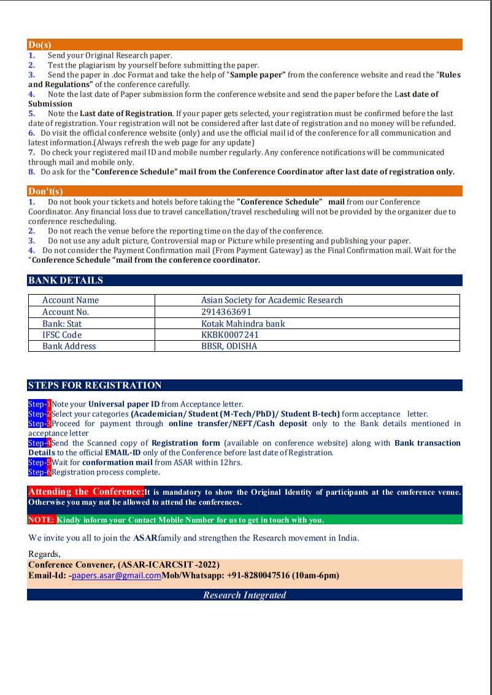
Letter Of Acceptance

Slide 9
Table Of Accuracies
K-Nearest Neighbour (KNN) | 87.9 %
Support Vector Machine | 84.6%
Random Forest Classifier | 86.8%
Decision Tree Classifier | 82.4%

Slide 10
References
[1] – https://iopscience.iop.org/article/10.1088/1757-899X/1022/1/012072/meta
[2] - https://bbrc.in/wp-content/uploads/2021/01/Galley-Proof-006.pdf
[3] - https://www.researchgate.net/publication/351545128_Heart_Disease_Prediction_Using_Machine_Learning
[4] - https://www.researchgate.net/publication/341870785_Heart_Disease_Prediction_using_Machine_Learning

Slide 11
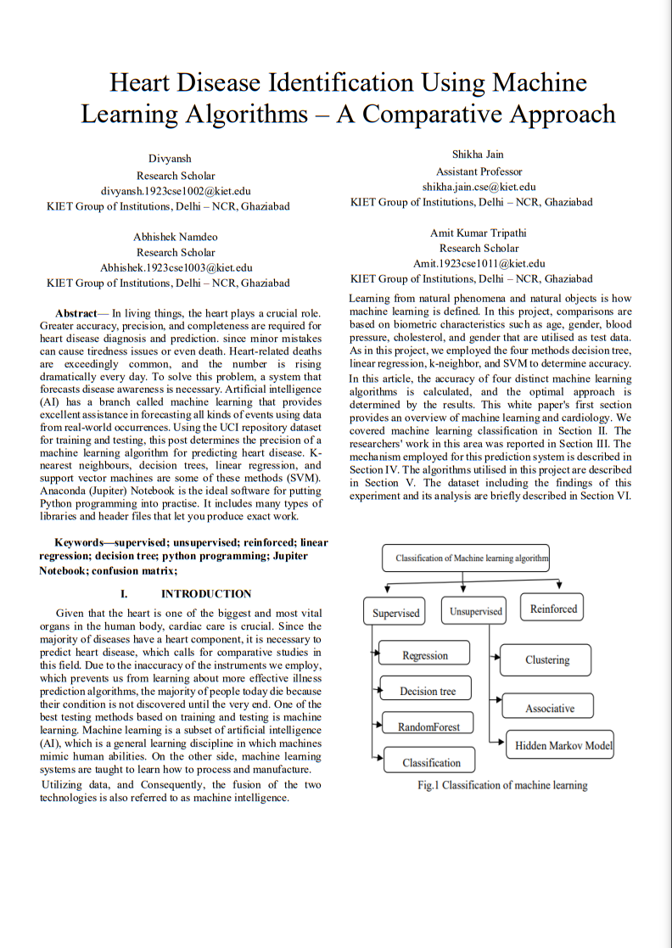
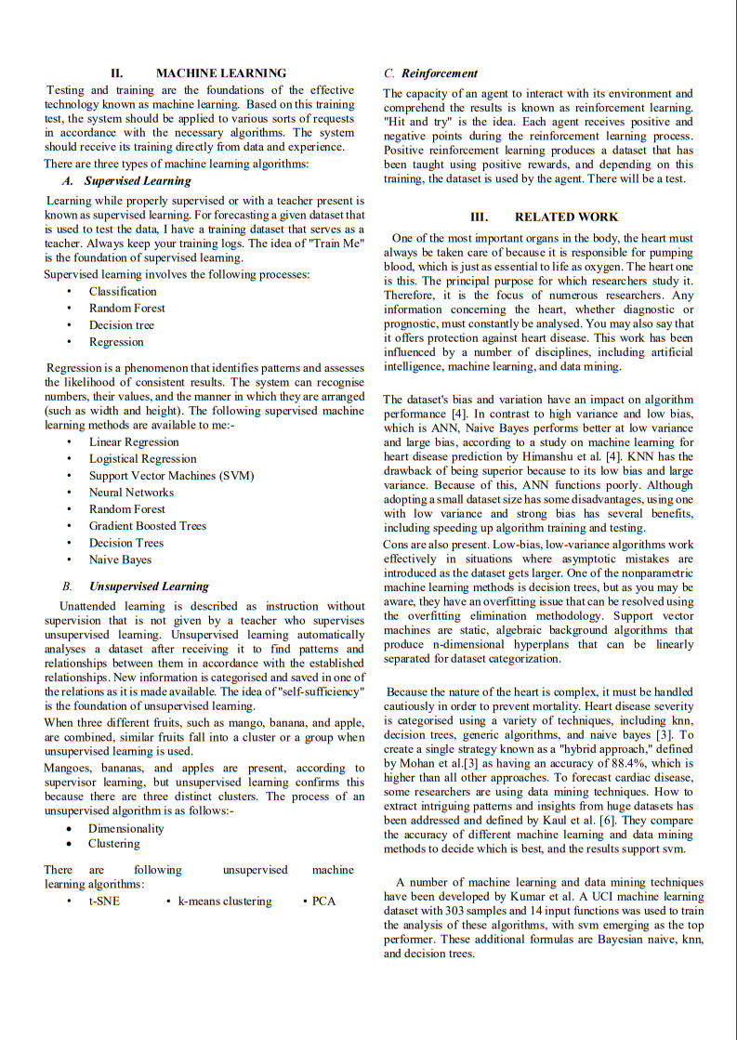
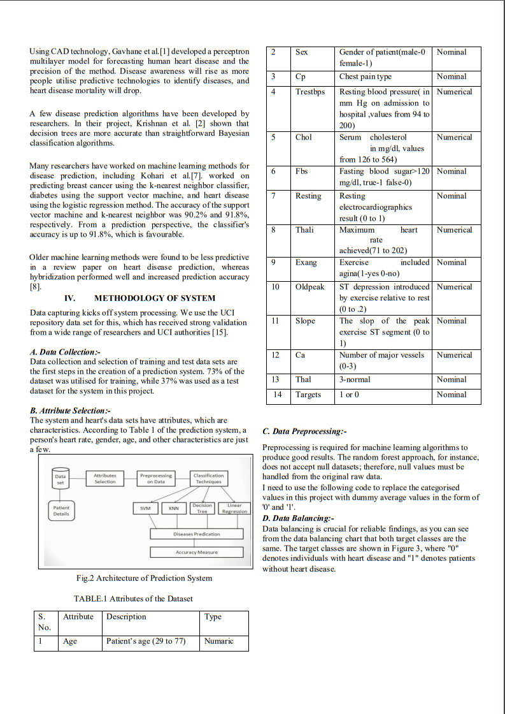
Research Paper

Slide 12
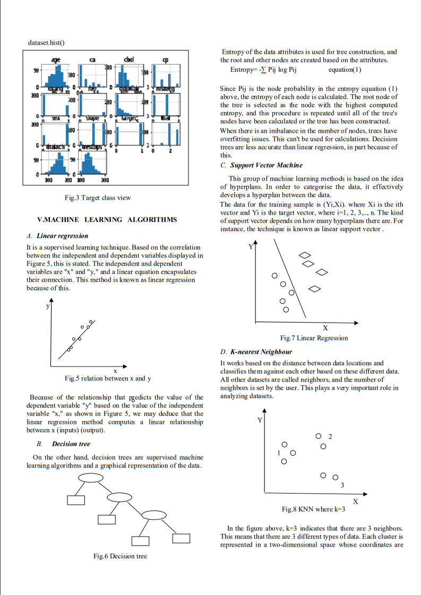
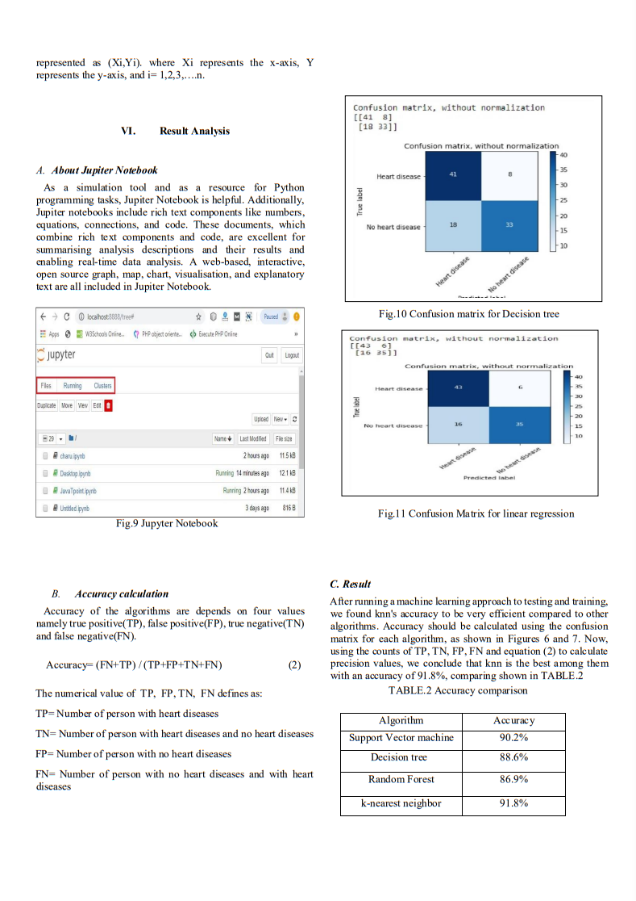
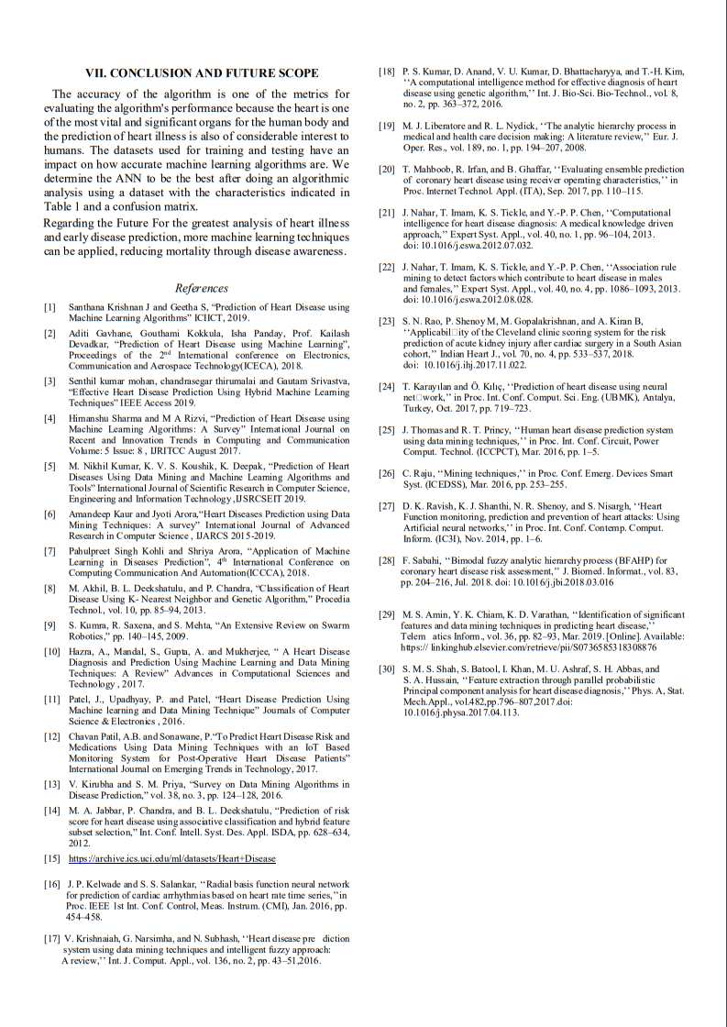

Slide 13
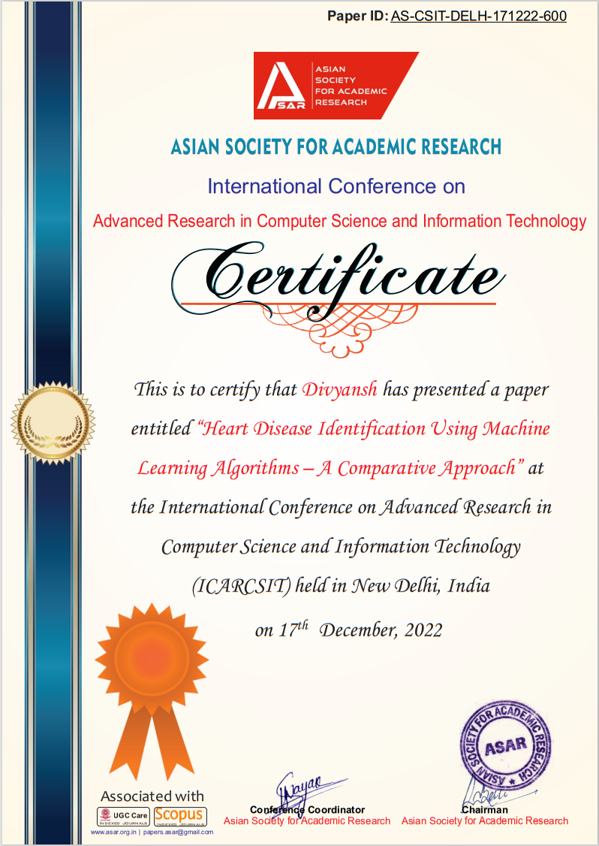

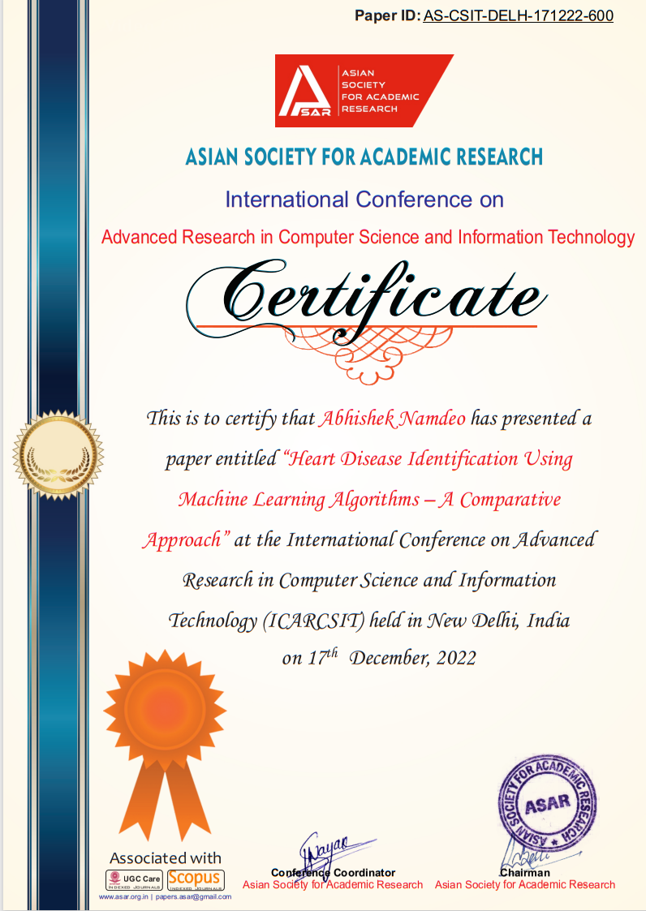
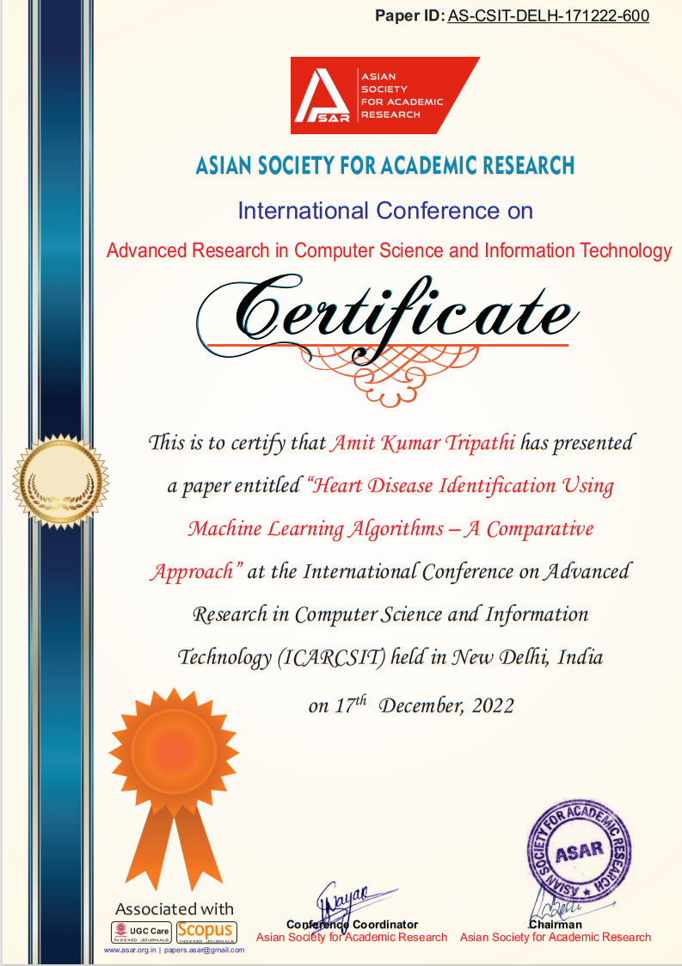
Certificates

Slide 14
Thank you.!

